Slide 1
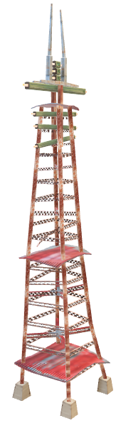
Insights: Wavecon Telecom Dashboard
Presented by : Bhanu Prakash Sarella

Slide 2
Content overview
Impact of 5G launch on revenue
Performance of KPIs post 5G launch
Revenue performance of plans after 5G launch
Impact on specific plans due to 5G
Plans discontinued post 5G launch

Slide 3
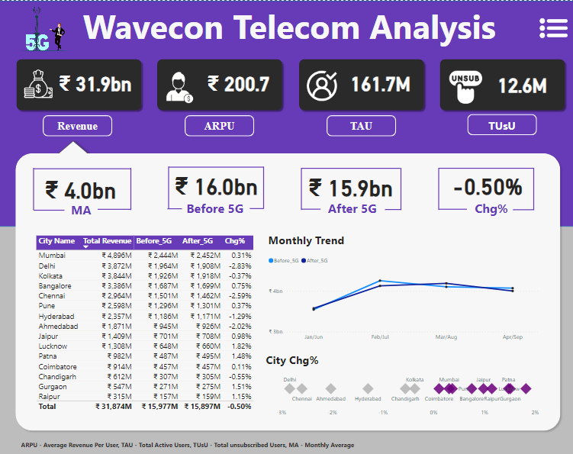
Impact of 5G Launch on Revenue
Company Overview Metrics:
Revenue: ₹31.9 billion
ARPU (Average Revenue Per User): ₹200.7
TAU (Total Active Users): 161.7 million
TuSU (Total unsubscribed Users): 12.6 million
5G Impact Analysis:
Revenue Before 5G: ₹16.0 billion
Revenue After 5G: ₹15.9 billion
Change Percentage (Chg%): -0.50%
Revenue By City:
A table listing different cities such as Mumbai, Delhi, Kolkata, and others, showing Total Revenue, Revenue Before 5G, Revenue After 5G, and the Change Percentage for each city.

Slide 4
Impact of 5G Launch on Revenue
Monthly Trend Graph:
Line graph displaying monthly revenue trend.
Compares revenue before and after 5G from Jan/Feb to Apr/Sep.
Shows a slight decline over time.
City Change Percentage Graph:
Bar graph indicating change percentage in revenue per city.
Chennai, Ahmedabad, and Hyderabad show noticeable decreases.
Patna shows an increase.
Icons and Graphics:**
5G icon representing 5G technology.
Phone with arrow symbolizing Average Revenue Per User (ARPU).
People figures indicating Total Active Users (TAU).

Slide 5
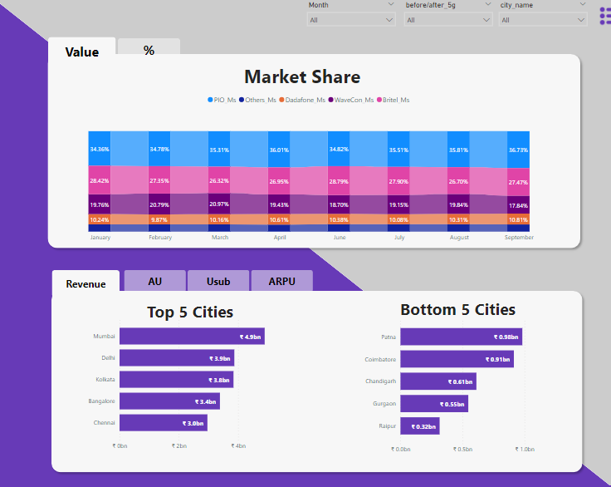
Market Share insights
Market Share:
Displayed using a stacked bar graph.
Covers market share percentage from January to September.
Telecom providers labeled: Pio Ms, Others Ms, Datafone Ms, WaveCon Ms, Britel Ms.
WaveCon Ms represents Wavecon Telecom's market share.
Fluctuation in WaveCon Ms:
- High of 10.23% in January.
- Low of 10.13% in August and September.
Ms –Market Share

Slide 6
Market Share insights
Top 5 Cities:
Mumbai, Delhi, Kolkata, Bangalore, Chennai included.
Mumbai leads in revenue: ₹4.5 billion.
Active Users (AU), Unsubscribed Users (Usub), Average Revenue Per User (ARPU) data provided.
Bottom 5 Cities:
Cities listed: Patna, Coimbatore, Chandigarh, Gurgaon, Raipur.
Patna has least revenue: ₹0.98 billion.
Ms –Market Share

Slide 7
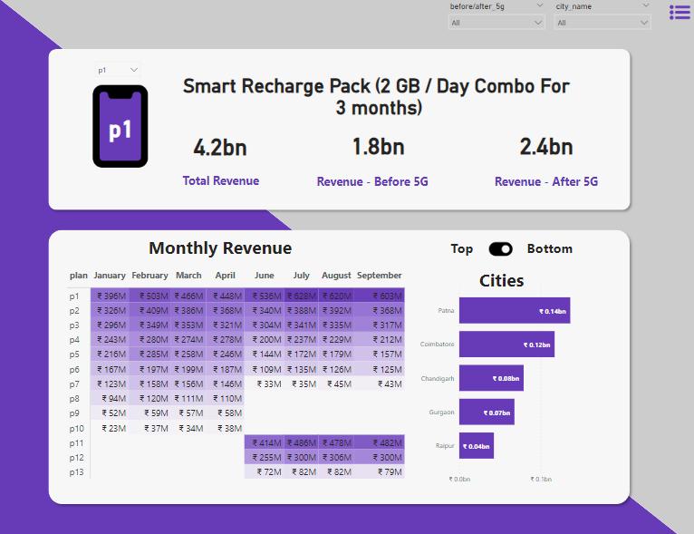
Performance of Plans in Terms of Revenue
Smart Recharge Pack Overview:
Total Revenue: ₹4.2 billion
Revenue - Before 5G: ₹1.8 billion
Revenue - After 5G: ₹2.4 billion
Monthly Revenue:
A table detailing revenues generated each month from various plans (p1 to p13) from January to September.
Plan p1 seems to be the most profitable, consistently generating the highest revenue every month, with September being the peak at ₹6.03M.

Slide 8
Performance of Plans in Terms of Revenue
Performance by City:
Partial view of top and bottom performing cities shown.
Bottom performing cities: Patna, Coimbatore, Chandigarh, Gurgaon, Raipur.
Lowest revenue city: Patna at ₹0.14 billion.
Combined view provides comprehensive insight into company's financial performance.
Highlights contribution of specific products like Smart Recharge Pack to revenue.
Shows impact of 5G on earnings.
Illustrates geographic distribution of revenue across cities.

Slide 9
Overall Insights of the dashboard:
Financial Overview and 5G Impact:
Wavecon Telecom has experienced a revenue of ₹31.9 billion with an Average Revenue Per User (ARPU) of ₹200.7.
The introduction of 5G technology seems to have slightly decreased revenue from ₹16.0 billion before 5G to ₹15.9 billion after 5G, indicating a marginal negative impact of -0.50% on revenue. The Total Active Users (TAU) stood at 161.7 million, with 12.6 million unsubscribed users.
Market Position and City-wise Performance:
Market share fluctuated, stabilizing around 10.13%
Top contributing cities: Mumbai, Delhi, Kolkata
Lowest contributing cities: Patna, Coimbatore, Chandigarh
Product Performance:
The Smart Recharge Pack, which offers 2 GB/Day Combo for 3 months, has generated a total revenue of ₹4.2 billion, with an increase in revenue post-5G introduction (₹2.4 billion after 5G compared to ₹1.8 billion before 5G). This suggests that some products may have benefited from the new technology.

Slide 10
COnclusion
Wavecon Telecom's overall revenue has slightly declined after 5G introduction.
Revenue variances observed across different cities.
Stable market share maintained in a competitive landscape.
Smart Recharge Pack revenue increased post 5G launch.
Indication of customer interest in enhanced 5G services.
Some cities experienced revenue decrease, while others showed growth post 5G.
Non-uniform impact of 5G across regions.
Company needs to adapt and innovate to leverage 5G's full potential.
Aim to improve market position and profitability.

